Slide 1
Big Data Final Demo
“Classify activities by Sensors”
Yu Chieh Wang 11641327
Thunradee Tangsupakij 11616232
Xinyi Wang 11653817

Slide 2
Catalog
Project Topic
Dataset Analysis
Research & Techniques
Prediction model
Result
Problems
Q & A
Reference

Slide 3
Project Topic
Classify the activities of a person by amplitude of vibrations which are recorded by sensors.

Slide 4
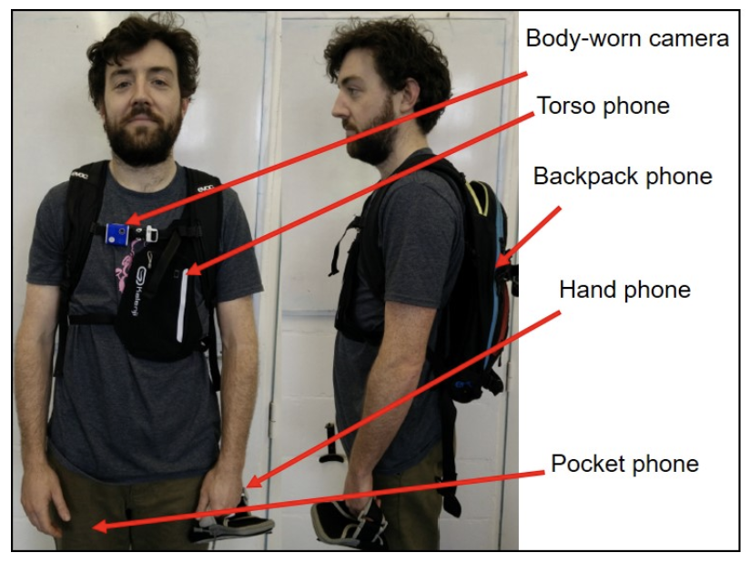
Project Topic
A person
wears 4 devices
Torso
Backpack
Hand
Pocket
records a day.

Slide 5
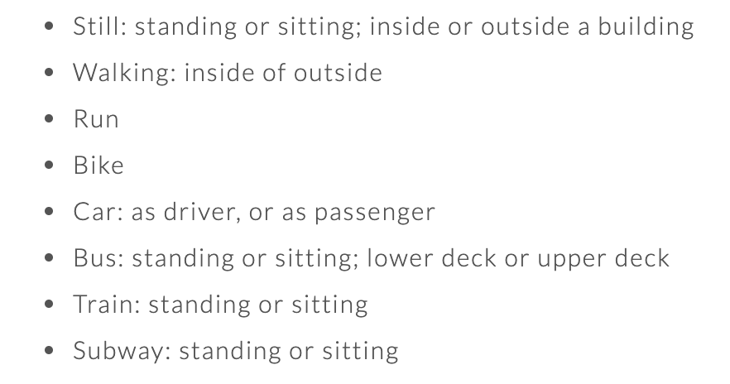
Project Topic
8 labels for classification

Slide 6
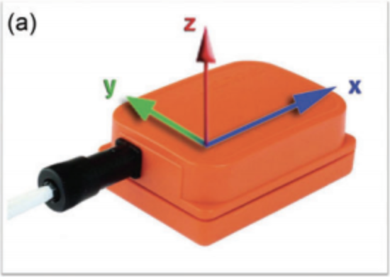
Project Topic
X, Y, Z positions
Horizontal direction
X and Y
Vertical direction
Z

Slide 7





Dataset Analysis
Data description

Slide 8
Dataset Analysis
Data description
Label.txt
Motion.txt(Torso, Backpack, Hand, Pocket)
Time | Coarse label
[ms] | {1:”Still”, 2:”Walking”, 3:”Run”, 4:”Bike”, 5:”Car”, 6:”Bus”, 7:”Train”, 8:”Subway”}
 | Acceleration |  |  | Gyroscope |  |  | Magnetometer
Time | X | Y | Z | X | Y | Z | X | Y | Z
[ms] | [m/s2] | [m/s2] | [m/s2] | [rad/s] | [rad/s] | [rad/s] | [μT] | [μT] | [μT]

Slide 9
Research & Techniques
Tools
Database
Data Description
Data Processing
Classification method

Slide 10


Tools
Notes:
For the tools, We used Python language and Pycharm environment for data anlysis

Slide 11


Database
MySQL Workbench
http://www.suncoreedb.com/amazonaurora.htm
https://twitter.com/mysqlworkbenchl
Notes:
Moving on to database, we used Amazon Aurora to host our database and MySQL Workbench to work with the database

Slide 12
SQL
Finite data size
Well structured data
Fimilar to SQL
Notes:
Even Though SQL databases wouldn’t be the best fit for sensor data because it has scalability issue
but in this project we worked on finite size of data
and our data is well structure,
so Amazon Aurora MySQL is a good choice for us

Slide 13
Amazon Aurora MySQL
A relational database
Performs up to 5x MySQL
MySQL compatible
High availability and replication
http://www.suncoreedb.com/amazonaurora.htm

Slide 14
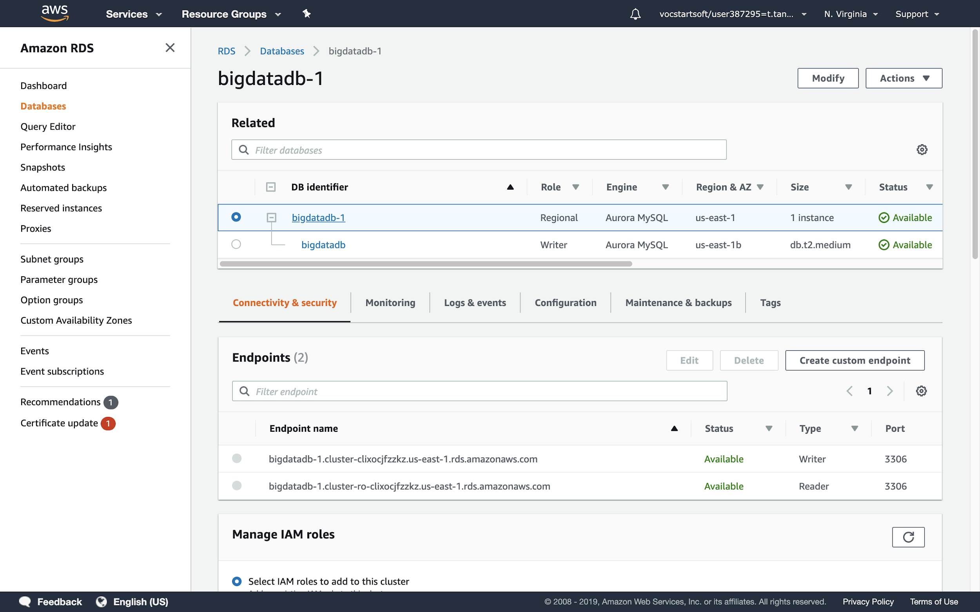
Amazon Aurora MySQL

Slide 15
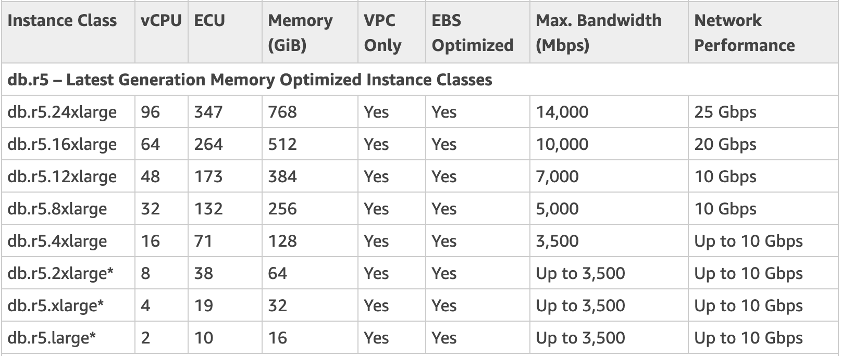
DB.r5.large Instance
3,500/8
=437.5 MB/sec
Motion files = 1.09GB * 4 = 4.36GB
Label file = 134.8MB
~11 Sec
+= 4,494.8MB
https://docs.aws.amazon.com/AmazonRDS/latest/UserGuide/Concepts.DBInstanceClass.html
Notes:
Amazon Aurora has different types of database instances
When we first created the database we planed to use db.r5.large.
The a motion file has ruftly about 1 GB, we has 4 motion files, so it’s ruftly about 4 GB
The Label file’s size is about 135MB
So our data size will be ruftly 4,500MB
db.r5.large has up to 440 MB/sec

Slide 16
However
Running out of AWS credits
Didn’t know why ..
Change the DB instance to a smallest one

Slide 17
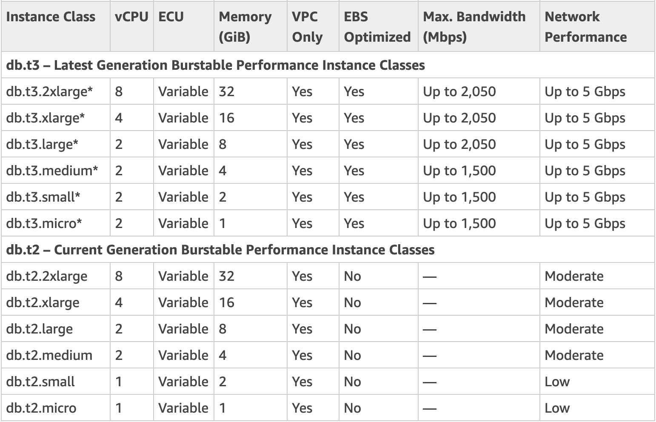
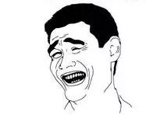
Expectation
Reality

Slide 18
Problems
Small DB instance works super duper slow; 4-5 hrs

Slide 19
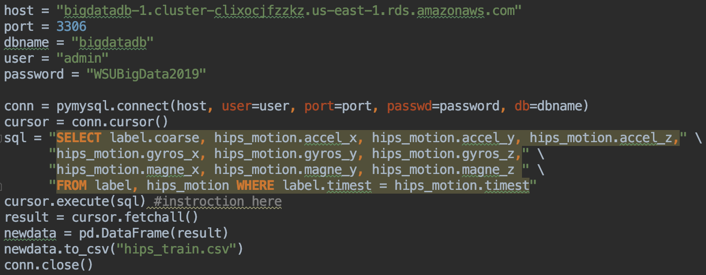
Solution
Download data from database by SQL
Make all data as a CSV file

Slide 20
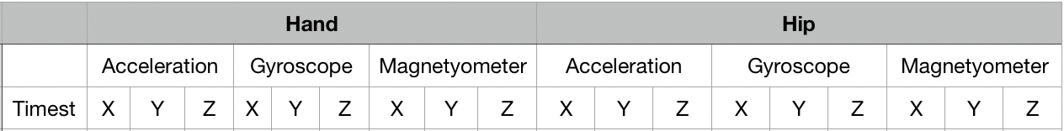
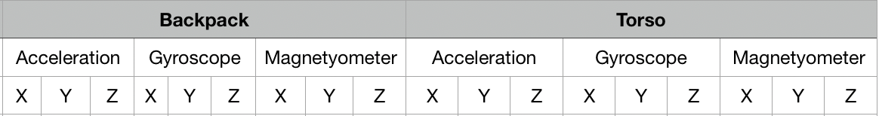
Data Description
CSV file 1 + 9 x 4 = 37 features.

Slide 21
Data Processing
CSV file
data
Still Walking Run Bike Bus Car Train Subway
30000
examples
130000
examples
training testing

Slide 22

Classification Method
Depending on the positions of the sensors on human body, the detected values are slightly different.
i.e: When a person is biking, the sensors in the backpack and pockets catch the amount of LHS and RHS shaking more than the chest.

Slide 23
Prediction model
Decision tree classifier algorithm is implemented for the prediction model.
Adventages:
It can be interpreted as a table of if-then rules, an instance needs conditions that need to be met.
No complicated parameters to set up.
No need for iteration training.
High running speed.

Slide 24
Prediction model
Step 1: Load the dataset of labels and features of all activities.
Step 2: Shuffle the dataset in order to generate more scientific results.
Step 3: Fit the data into DecisionTreeClassifier model.
Step 4: Score the result by printing out the accuracy and confusion matrix

Slide 25
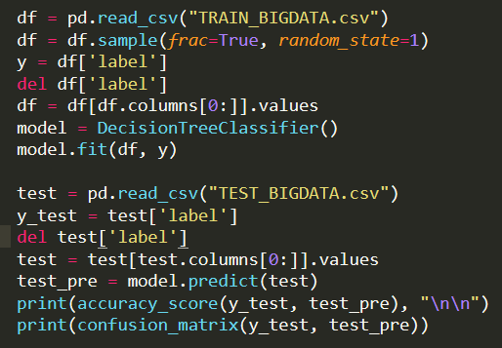
Prediction model

Slide 26
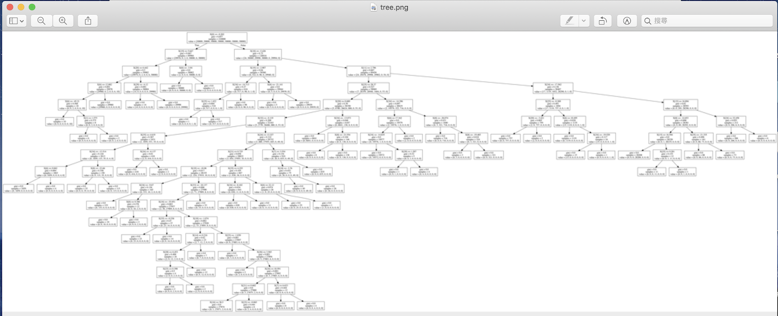
Result
Decision Tree

Slide 27
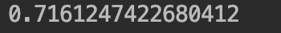
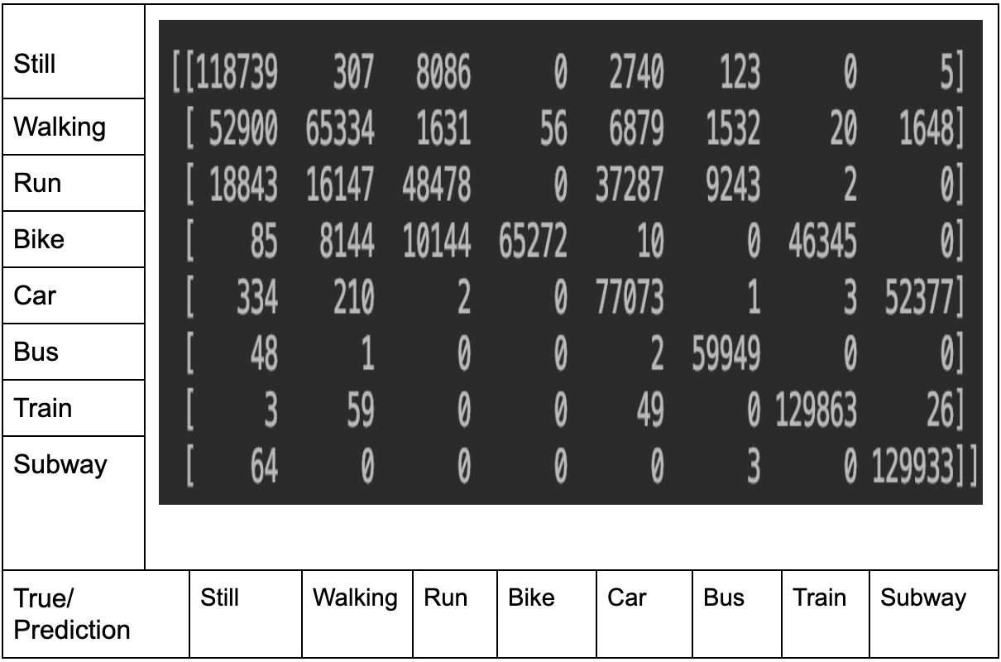
Result
Accuracy

Slide 28

Problems

Slide 29
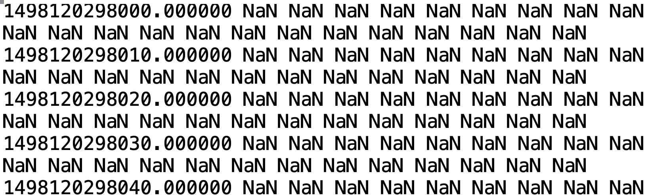
Problems
How to deal with missing data? There are a lot of “NaN” in our data. i.e: at the begining of the experiment when people doesn’t do anythong.

Slide 30
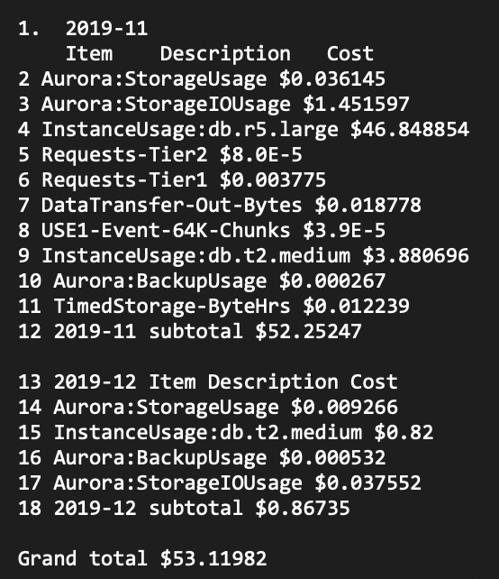
Problems
Small DB instance works super duper slow; 4-5 hrs
Large DB instance is pricy $0.29/hr, $6.96/day
Ran out of AWS credits

Slide 31

Q & A

Slide 32
Reference
Project Topic http://www.shl-dataset.org/download
Time Series Analysis https://github.com/Sirius79/HAR-Time-Series-Analysis
H. Gjoreski, M. Ciliberto, L. Wang, F. J. O. Morales, S. Mekki, S. Valentin, D. Roggen. “The University of Sussex-Huawei Locomotion and Transportation Dataset for Multimodal Analytics with Mobile Devices.” IEEE Access 6 (2018): 42592-42604.
L. Wang, H. Gjoreski, M. Ciliberto, S. Mekki, S. Valentin, and D. Roggen, “Enabling reproducible research in sensor-based transportation mode recognition with the Sussex-Huawei dataset,” IEEE Access 7 (2019): 10870-10891.

